Slide 1


TRAFFIC LEVEL PREDICTION
A study on the city of Torino
A project by Four pandas

Slide 2
We are… Four pandas!
Marco Martellacci
#Scientist
Stefano Calderan
#DataScientist
#MangaLover
Marek Kufel
#BIDeveloper
Daniele Morano
#Developer
#Murdock

Slide 3
Our Goal
Check if it is possible to predict traffic levels in a specific area of the city, with a reasonable forecast window
How is traffic level defined?
What is a specific area?
What do we mean by reasonable forecast window?

Slide 4
Starting Point
VEM dataset 28 GB across 4 datasets
JUNE 2017
JULY 2017
JANUARY 2018
FEBRUARY 2018
device_id | recording date | latitude | longitude | speed | engine status
device_id | recordingdate | latitude | longitude | speed | heading | gps quality | engine status | acceleration | meters

Slide 5
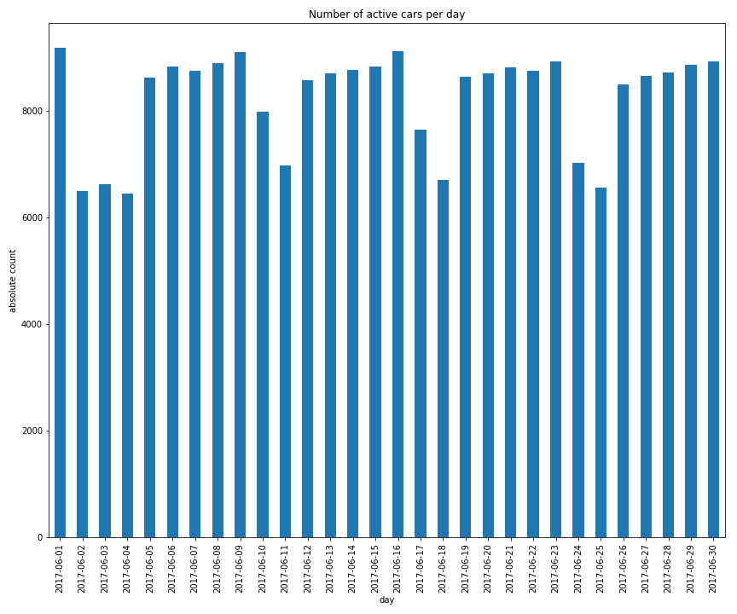
Quick Insight on Data
We selected the Torino area as a rectangle with minimum and maximum borders:
(7.57785 ; 7.77337)
(45.00678 ; 45.1402)
Total number of active cars:
20158

Slide 6
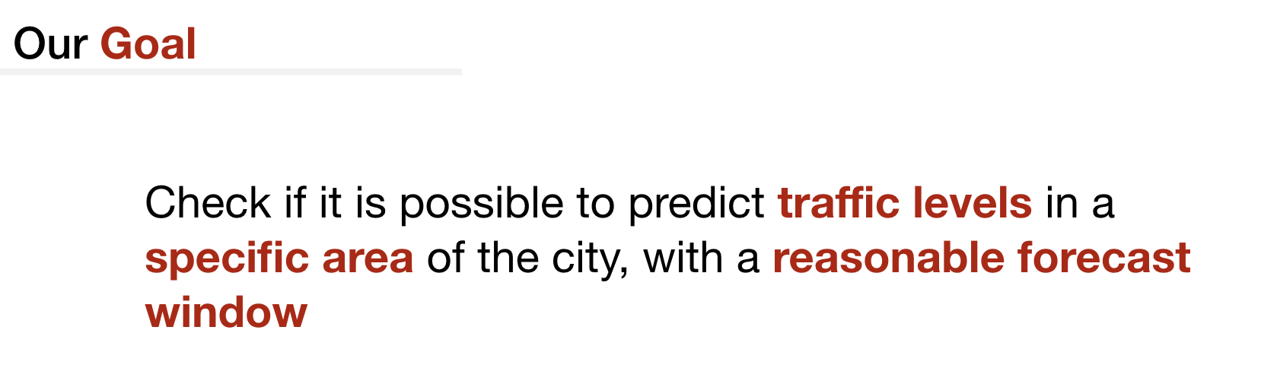
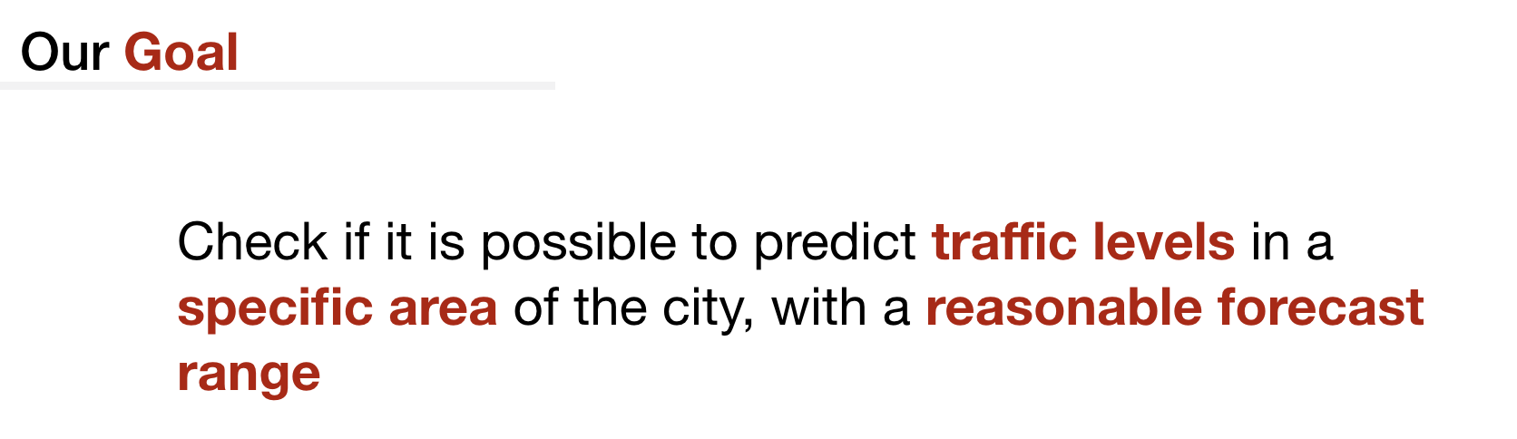
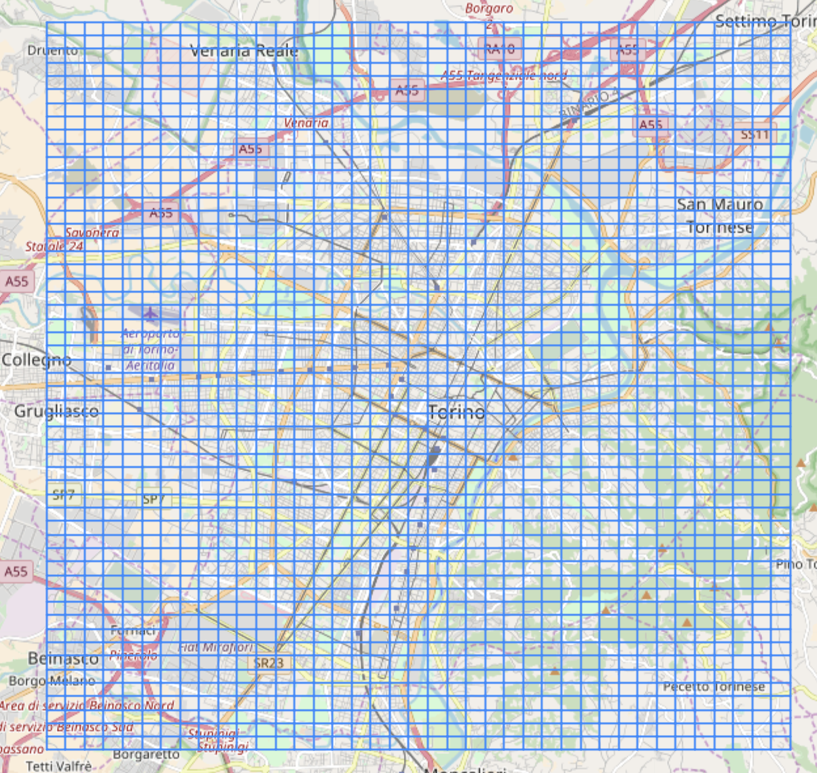
Grid Creation
Initial choice for rectangle shaped zones.
Size of 400 m x 250 m
Started with 55 x 40 = 2220 zones
Original idea: predict traffic levels for every zone in the grid

Slide 7
A metric for traffic levels
$$TL(l,t)=\frac{N(l,t)}{{⟨v⟩}_{N}}$$
Is this good?

Slide 8
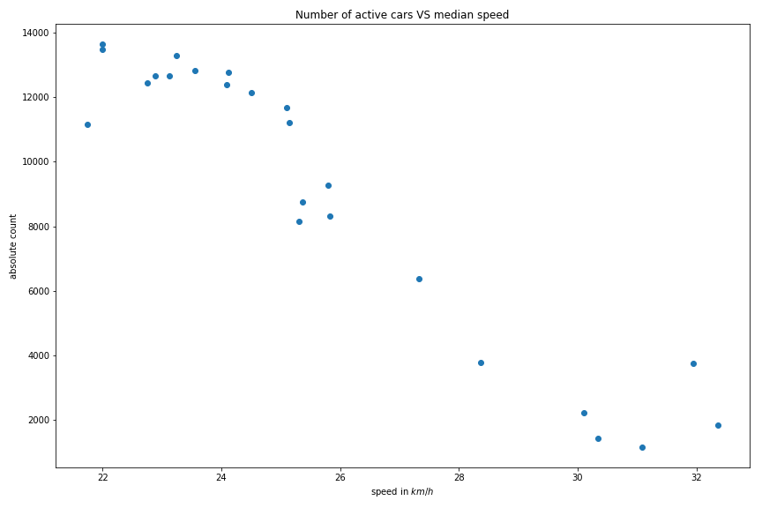
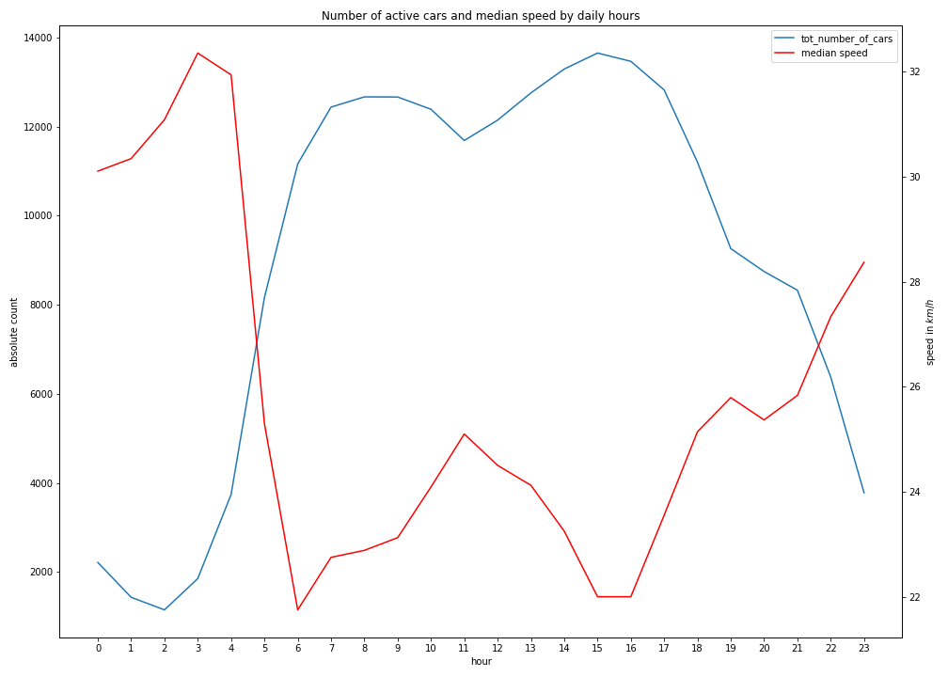
Number of active cars VS median speed
Exploratory analysis: daily hours
Pearson coeff: r = - 0.95
Number of active cars and median speed by daily hour

Slide 9
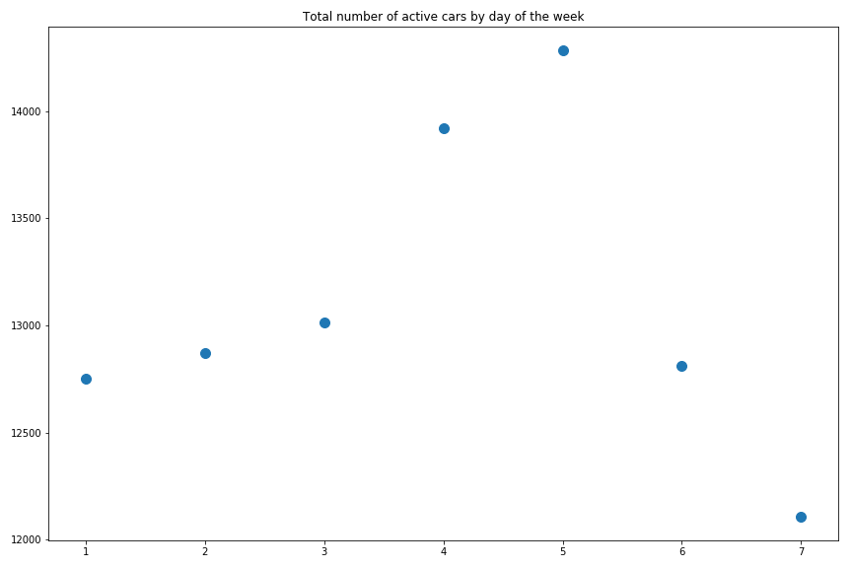
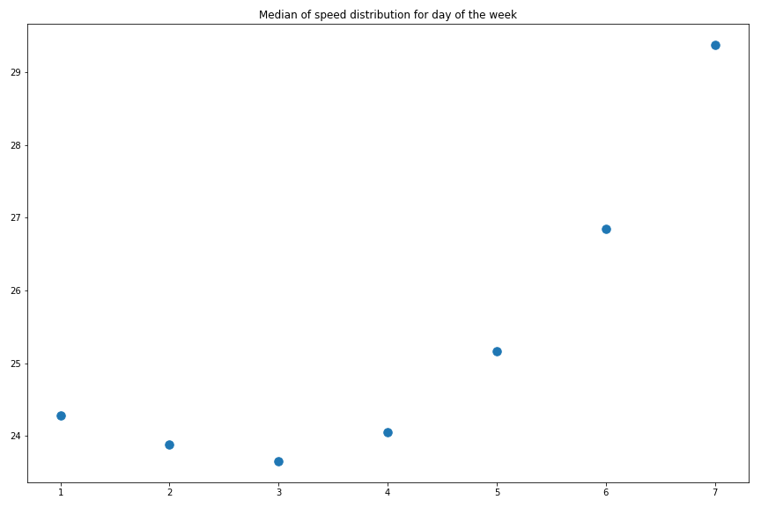
Exploratory analysis II: weekdays
Total active cars by day of the week
Median speed by day of the week

Slide 10
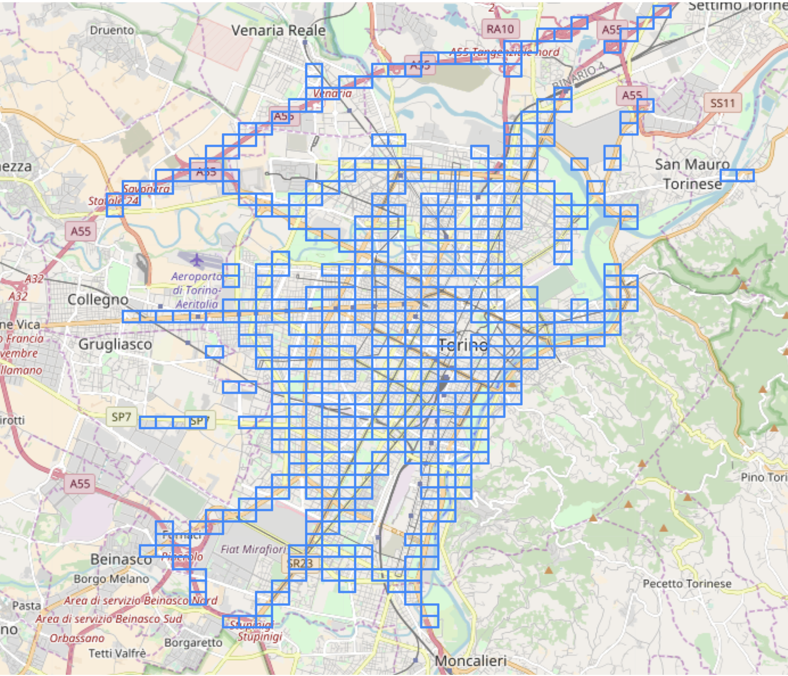
Focus on grid zones selection
We decided to discard cells with data that could lead to unreliable traffic estimations.
The selection criterion was based on the average daily count of distinct cars crossing the zone.
Furthermore, we requested at least one neighbour for each zone.
Final number of zones:
500

Slide 11
Facing a time tradeoff
$$TL(l,t)=\frac{N(l,t)}{{⟨v⟩}_{N}}$$
At the same time, we want a forecast range that is
large enough -> collects a statistically significant amount of data
small enough -> detects actual fluctuations of traffic levels
We selected a 30 minutes range

Slide 12
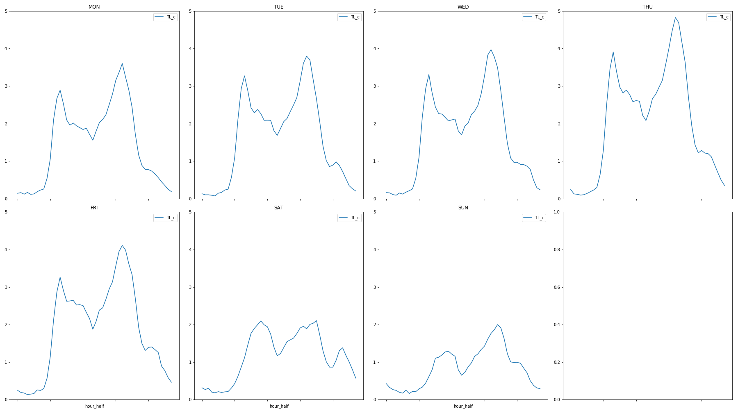
A panoramic of TL values
The values are aggregated for the whole city of Turin.
TL seems like a good metric for traffic levels
Working days looks very similar to one another

Slide 13
Time for data preparation
weekday_SA
time_stamp
zone_longitude
TL_previous_time
weekday_WD
weekday_SU
zone_latitude
TL_neighbours
Data was aggregated by type of weekday, time stamp and zone id: each input vector is a snapshot in time
Ready for building the dataset! But …

Slide 14
The first problem
Lack of traffic values data for many zones, across a lot of time windows
Majority of the problematic hours in the range between 1:30 AM and 7:00 AM
Solution keep data for time stamps between 7.00 AM and 1.30 AM (local time)

Slide 15
Algorithm selection
Regression problem
Select an informative and comprehensible metric r2 score
Baseline model for comparison: always output traffic level in previous time window
Different models for starting point:
Random Forest Regressor
Extremely Randomized Trees Regressor
Extreme Gradient Boosting (XGBoost)
Support Vector Machines

Slide 16
The second problem
Baseline model score: 0.28
After quick hyper-parameter tuning via CV, good r2 for trained model: 0.61
But …
Very poor performance on test set: 0.13 (strange even for overfitting)
Dataset had “false” outliers: TL values computed with very low number of cars, very slow for some reason (MSE heavily weights outliers).

Slide 17
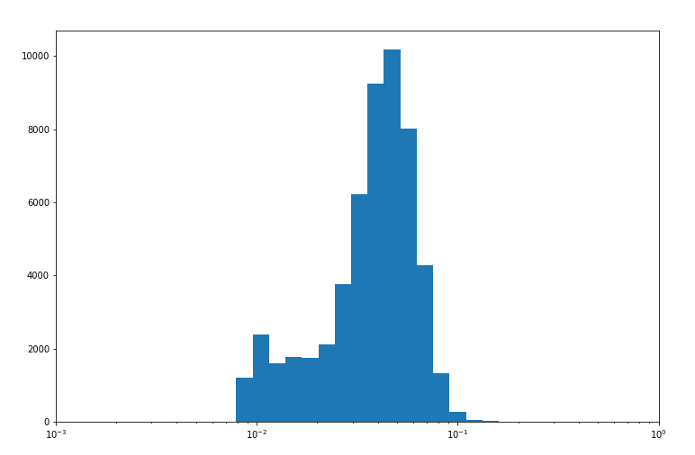
Further enhancing… why not?
All outliers had number of cars < 7 discard them
Lost ~ 1200 records out of 55450
Further improvement: log transform the target TL values normal log

Slide 18
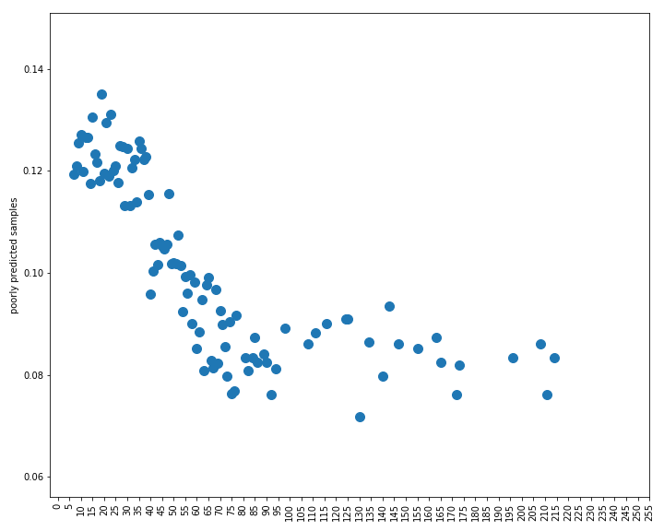
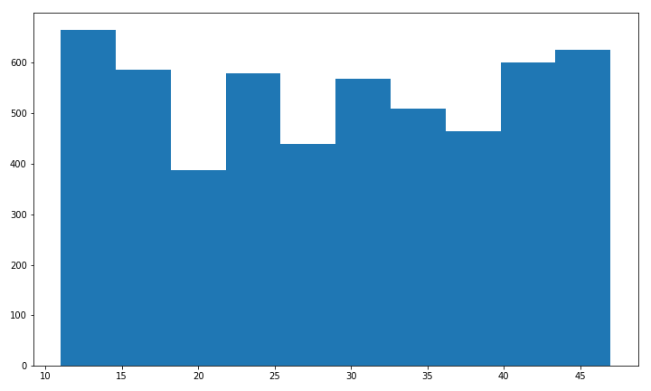
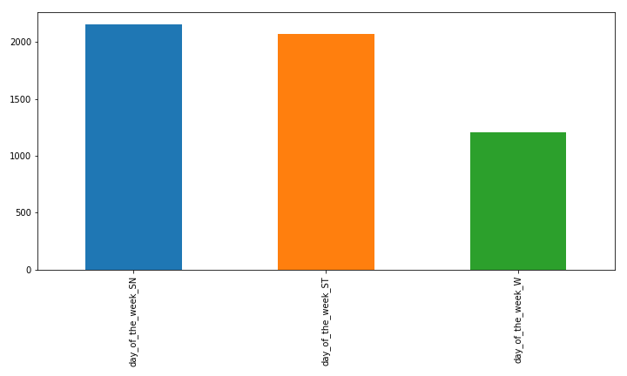
And at last… the results
Trained model (Extree Regressor):
0.917
(Baseline model score: 0.535)
Big error chance by car number
Big error chance by time stamp
Big error count by weekday
SU
SA
W

Slide 19
Happy ending: conclusions
It seems to be possible to have a nice estimate of traffic levels for a very specific area, and with good anticipation
Model merit: by collecting traffic jam values for a certain moment, one can have a good idea of future traffic, and know it 30 minutes ahead
Decision tool
Car drivers: “Should I take the car?”,”Should I rethink the route?”
City administration: “Should I do something about public transport?”

Slide 20
Epilogue: future developments
Explore the model with different grid and time window selection (either smaller or bigger)
Find a way to include discarded hours
Try with less features (location info maybe?)
Test performance on unseen months

Slide 21
Thanksgivings
A thanks to all our charming princes:
All BIGDIVE staff for support and patience
Alan, Paolo and Andrè from ISI for very precious suggestions and guidance in very dark hours
Laura for the very nice slide design

Slide 22
Thanks for your attention

